Slide 1
DBMS Project
E-commerce Database

Slide 2
Problem Statement
Design a Database for an E-commerce website.
A Product has a unique ID, Name, Price, Description, Available Sizes, etc.
Each Product belongs to a Category with Unique ID and Names.
A Supplier supplies the Product and a Shipper ships the Product.
A Customer buys a Product and then it is processed into an order.
Each Order has details about the Order like OrderID, OrderDate, Amount, Payment details, etc.
Both Customers and Sellers are users of the website and have contact info. like Phone No, Address, Email…
Admin manages Products by updating UnitsInStocks, Adding new Products

Slide 3
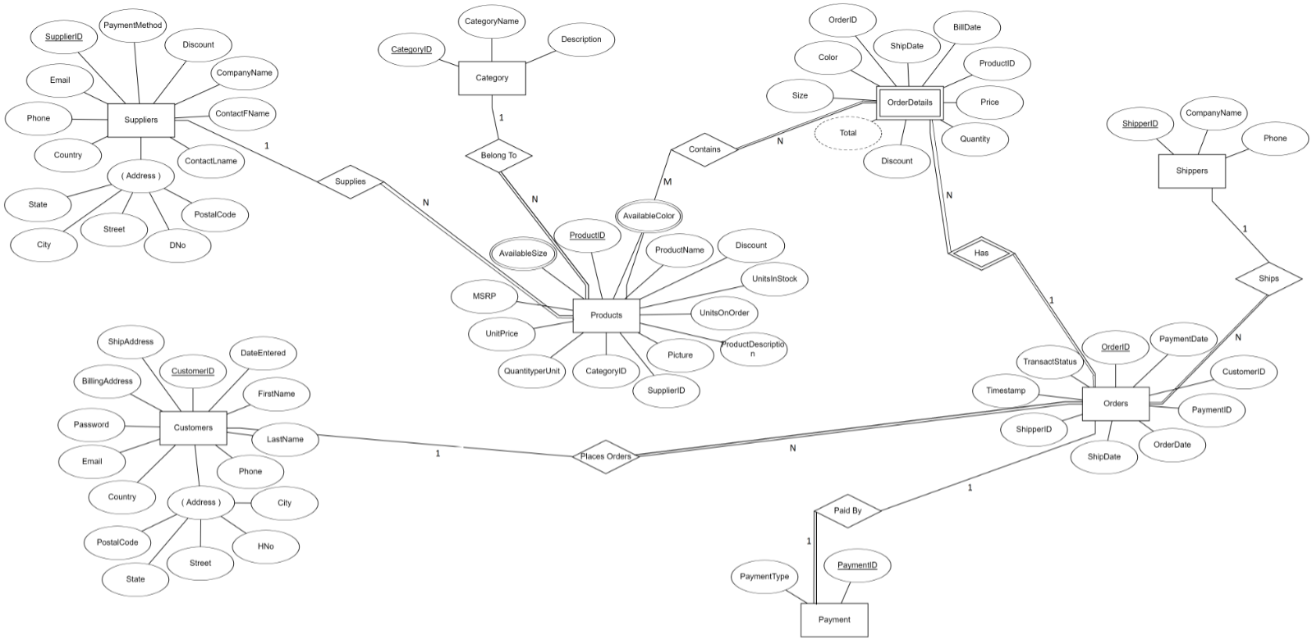

Slide 4
